Slide 1
Cold War Ideologies
By Jeff Rall II, Vicki Manstream, and Brandi Stevens

Slide 2

Capitalism
This flag represents the Americans and the USSR.

Slide 3

Capitalism
This was a political
cartoon during the
Cold War that
meant it was better
to be dead than live
in a communist
country.

Slide 4
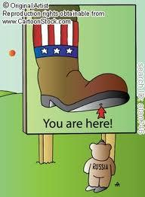
Capitalism
This picture shows
another political cartoon
in which Americans are
saying they will crush
the communists.

Slide 5
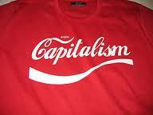
Capitalism
This picture
shows a T-shirt
that says
capitalism using
the coca cola
font to represent
marketing.

Slide 6
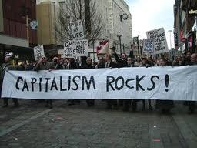
Capitalism
This shows people
getting together
to send a message
to their government
to convert to
capitalism.

Slide 7
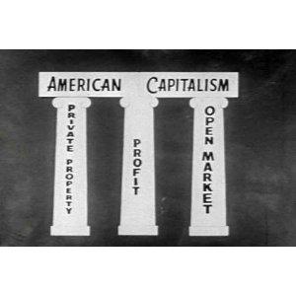
Capitalism
This shows the three
main points that
uphold American
capitalism.

Slide 8
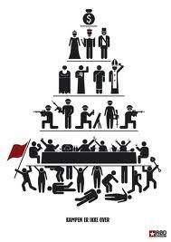
Capitalism
This shows how the world
works lower class uphold the
business people who are
below the military which is
under religion which is under
country rule all of which is
controlled by money.

Slide 9
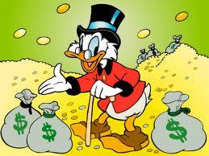
Capitalism
This is a cartoon showing how capitalism can achieve great wealth.

Slide 10
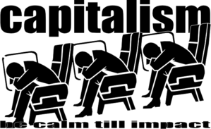
Capitalism
This is a negative picture meaning that capitalism is going to fail.

Slide 11
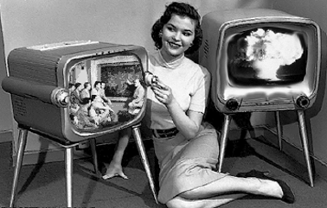
Capitalism
This shows when Americans finally got the television and were able to market them.

Slide 12
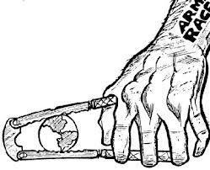
Communism
This picture shows
the world being
crushed meaning
the Russians were
trying to overthrow
the world during the
Arms Race.

Slide 13
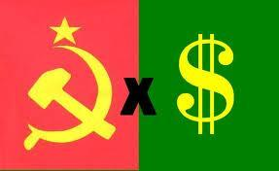
Communism
This image
shows how
the USSR
controls the
money flow in
the USSR by
controlling the country forcefully.

Slide 14
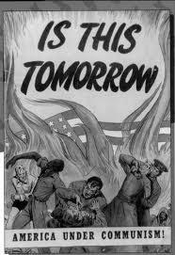
Communism
This image shows
communism trying to
overthrow America's
democracy.

Slide 15
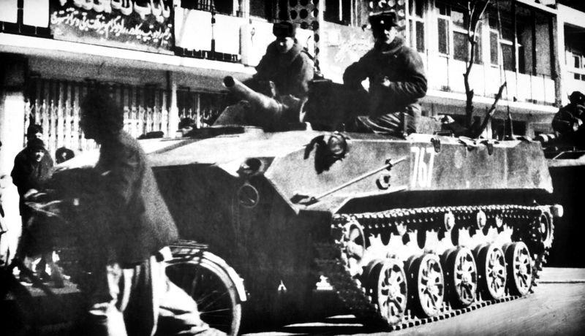
Communism
This shows the
Russians controlling
it's country by
force.

Slide 16
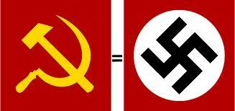
Communism
This is showing that communism is the same as being a Nazi.

Slide 17
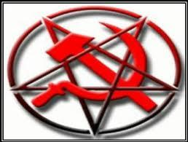
Communism
This shows the
Russian hammer
and sickle inside the
pentagram to show
communism is evil.

Slide 18
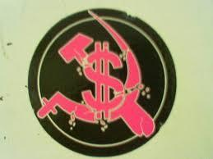
Communism
This shows how
the Russians
control the money
in its country.

Slide 19

Democracy
The world comes together.Everyone gets in a say in the laws and who becomes their "dictator" or as we know today the president. Everyone makes decisions together not just one person makes the decisions for everyone.

Slide 20
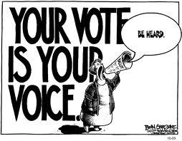
Democracy
Everyone,
gets the right to vote in a democracy government. Your opinion will be heard.

Slide 21
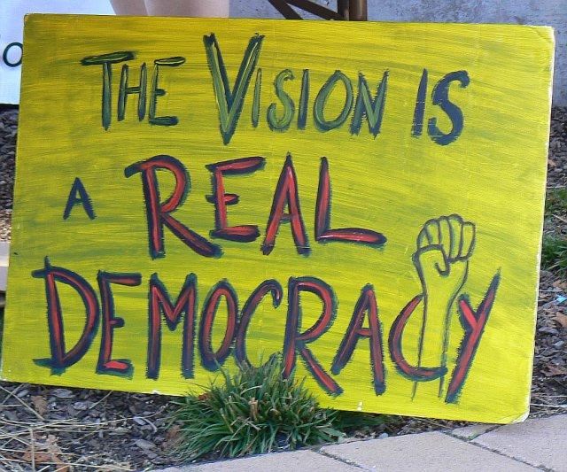
Democracy
This is showing how
people are embracing
democracy.

Slide 22
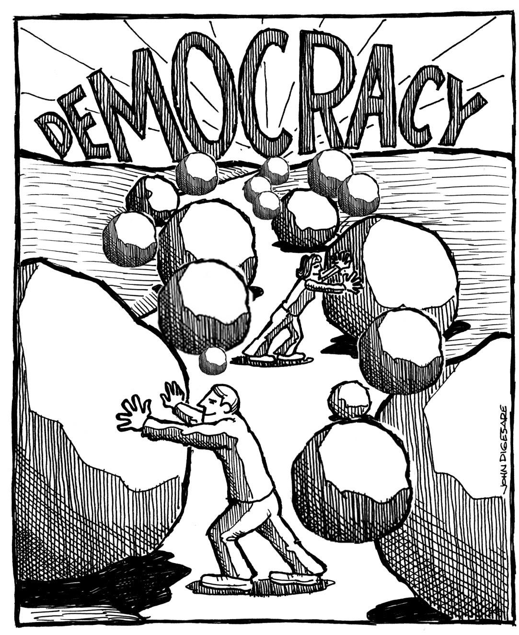
Democracy
This shows people clearing the rocky way to achieving democracy.

Slide 23
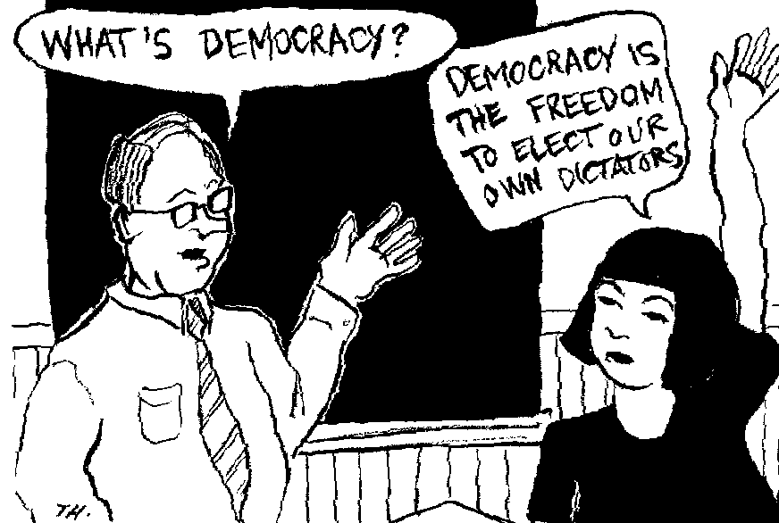
Democracy
When you have democracy you have the freedom to pick who is the leader but he is not the only man doing the job everyone is considered and makes the decisions together.

Slide 24
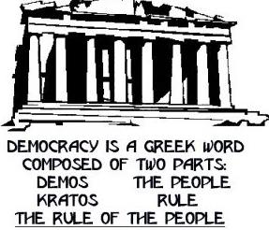
Democracy
This shows the meaning of democracy proving the people have a choice.

Slide 25
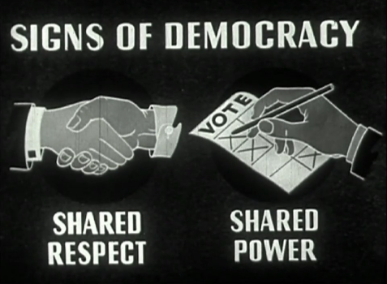
Democracy
~everyone is respected and created and treated equally.
~We all have equal freedom,voting is one of our rights as a country.

Slide 26
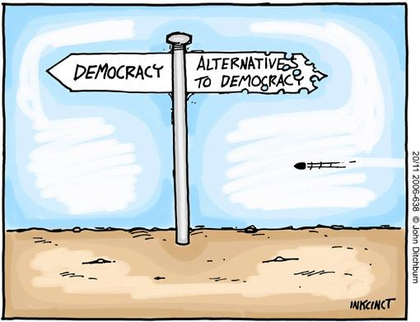
Democracy
This is saying that there is no better option than to be a democracy government because everyone is equal and treated fairly.

Slide 27
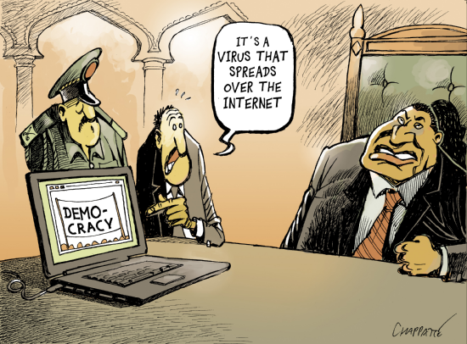
Democracy
Russia thinks Americas idea of democracy is stupid and they are talking bad on it saying its only a virus that spreads across the internet.

Slide 28
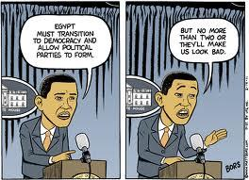
Democracy
Obama thinks that egypt should be more like us and be a democracy with two political parties, but he does not want them to have more than two and look better than us.

Slide 29
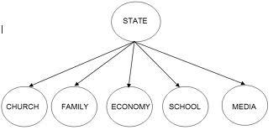
Totalitarianism
This shows how the states wanted to be in control of all the public and private lives of the people.

Slide 30
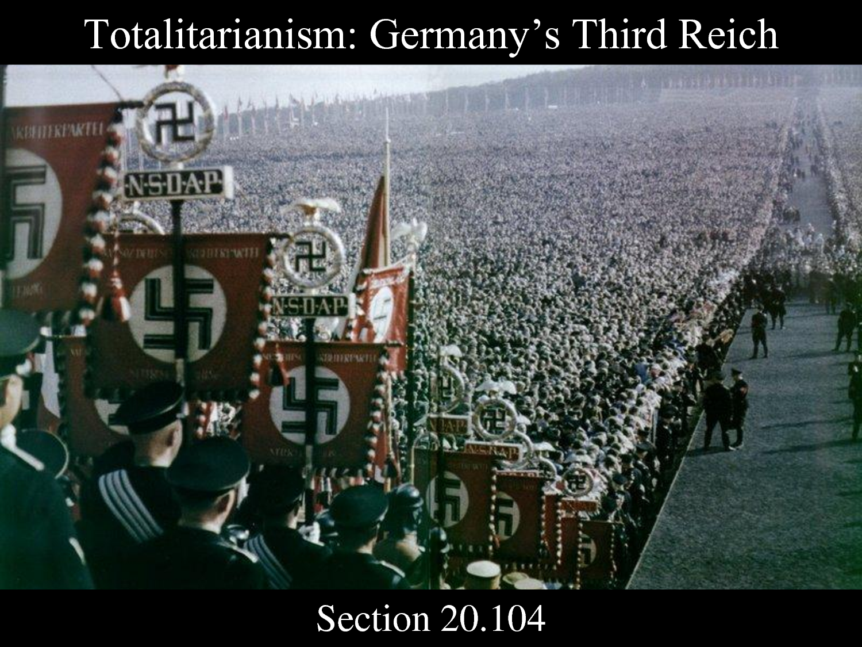
Totalitarianism
Shows how during this time the Germans and or Nazi's were taking control of everyone and everything. Also they always wanted to know what was going on no matter how they had to get the information from others.

Slide 31
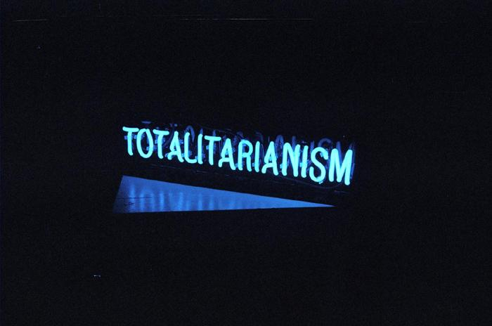
Totalitarianism
The definition of Totalitarianism is that the state wants to be in control of the public life and the private life.

Slide 32
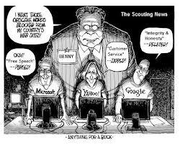
Totalitarianism
This picture shows the biggest man standing over the people watching everything that they are doing on the computers.

Slide 33
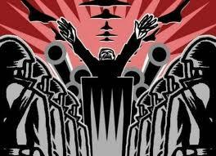
Totalitarianism
This one is showing the man in the middle making orders and making sure people are with him and not against him.

Slide 34
Bibliography
Works Cited
"The Capitalism Site | Laissez-faire capitalism is the political economic system based on individual rights." The Capitalism Site | Laissez-faire capitalism is the political economic system based on individual rights. N.p., n.d. Web. 19 Dec. 2012. <http://www.capitalism.org/>.
"Totalitarisme - WikipÃ©dia." WikipÃ©dia, l'encyclopÃ©die libre. N.p., n.d. Web. 19 Dec. 2012. <http://fr.wikipedia.org/wiki/Totalitarisme>.
"Democracy - Wikipedia, the free encyclopedia." Wikipedia, the free encyclopedia. N.p., n.d. Web. 19 Dec. 2012. <http://en.wikipedia.org/wiki/Democracy>.

